Slide 1














Domain : Finance
Predictive Modelling
for Insurance Claim
Analysis
Presented by :
Harshitha ( TL)
Syamala
Vishwas
Akshay
Client :Vajra.ai

Slide 2
Proposed Concept : Insurance claim analysis
Goal :
Built a model that can predict whether an insurance claim will be approved or not based on customer details and claim information.
Understanding Factors :
Policyholder Demographics : Age, Income, Mstatus,Gender,Education
Claim History : Clm_Freq, Old Claim, Clm_Amt
Policy Holder : Tif, Car_Use, Car_Type, Red_Car
Risk Assessment Criteria : Mvr_Pts, Car_Age,Travtime, Revoked

Slide 3




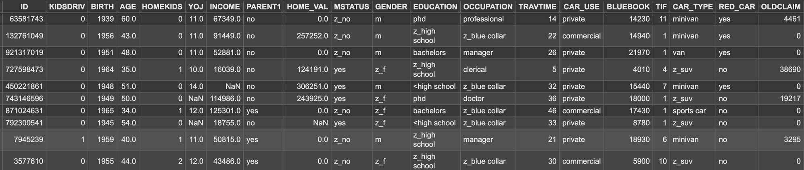
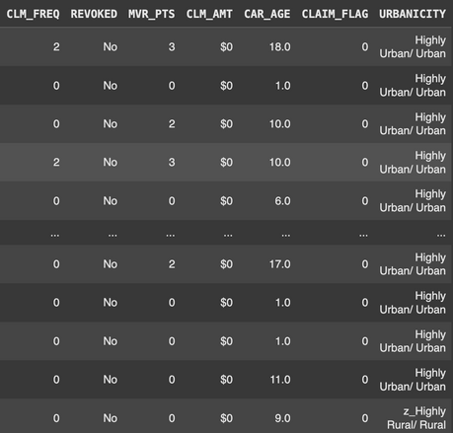


Dataset Collected : Kaggle
Data Details :
Columns Overview :
CLM_FREQ: Number of past claims.
OLDCLAIM: Value of previous claims.
CAR_AGE: Age of the car.
INCOME: Customer’s annual income.t
MVR_PTS: Driving record points.

Slide 4
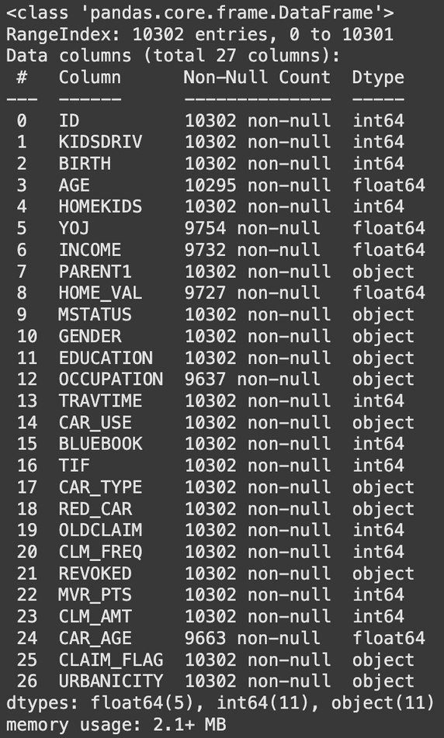
Data Validation
Used to checking whether the data is in correct format or not
Duplicate Rows:
Data info :
In this data we have negative value in car age column
By using abs() function we convert negative value into positive
After removing the duplicates we have 10,301 rows & 27 columns

Slide 5
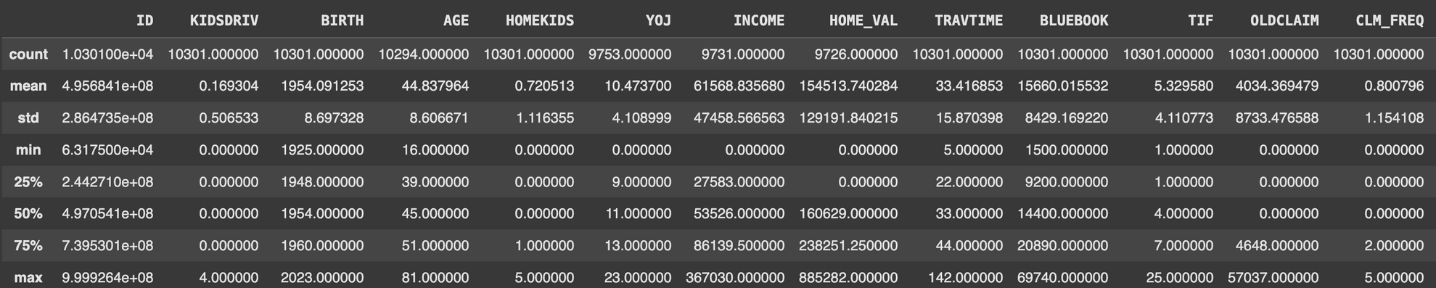
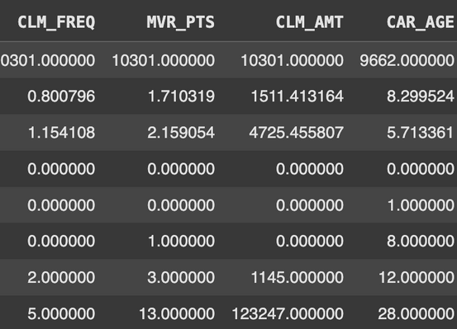
EDA
It is a process of analyzing and visualzing the data.
Descriptive Statistics :
Claim Amount: Most made no claims, but a few high claims raise the average to $1,511.
Income: Incomes average $61,568, with most earning around $53,526
Car Age: Cars are 8 years old on average, ranging up to 28 years.
Home Value: Average is $154,513, but many report $0 (likely renters).
Claim Frequency: Most filed no claims; average frequency is 0.8.
Travel Time: Commutes average 33 minutes, ranging from 5 to 142 minutes.
MVR Points: Most have clean records, but a few have up to 13 points.

Slide 6
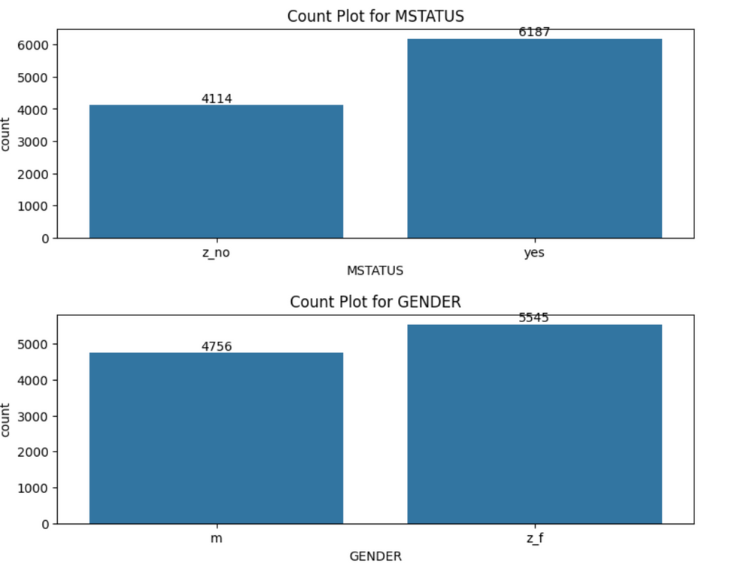
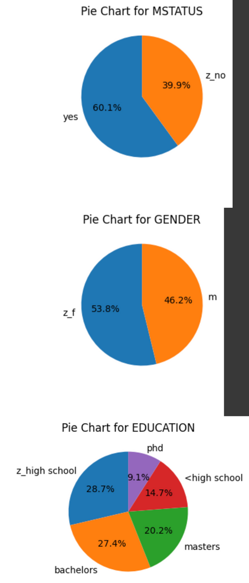
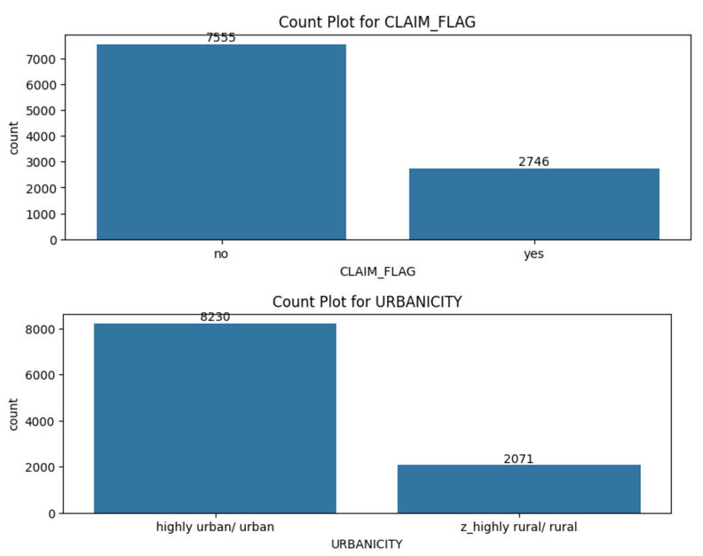
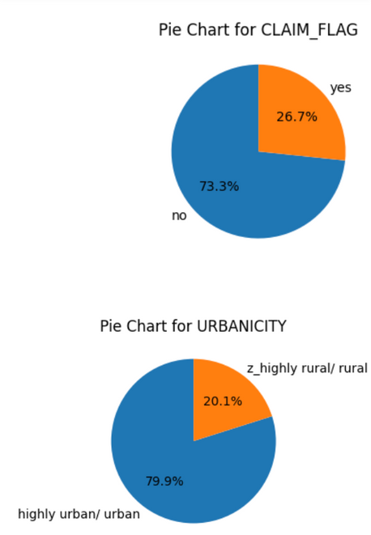
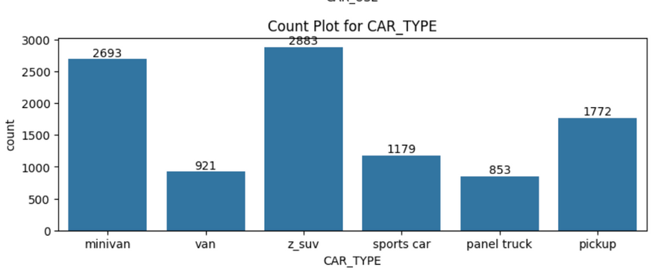
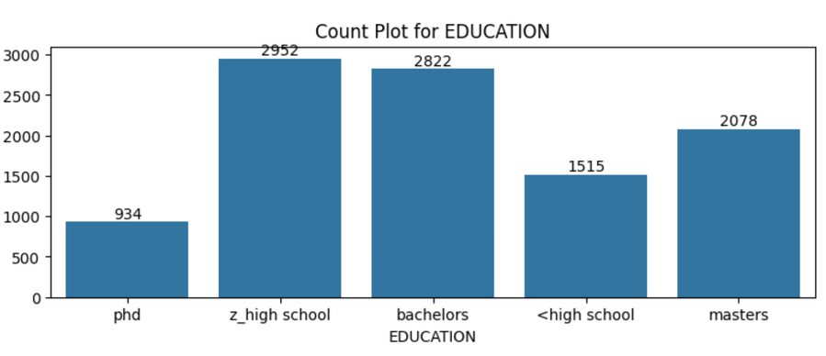
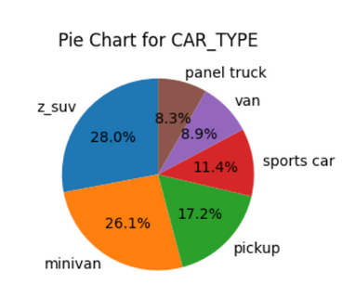
Univariate Column

Slide 7
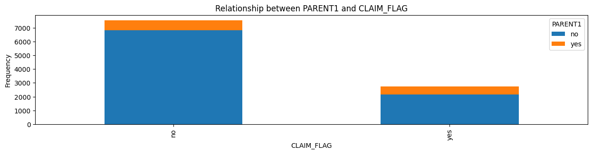
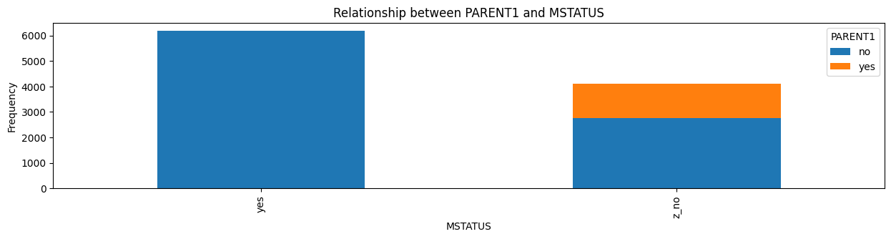
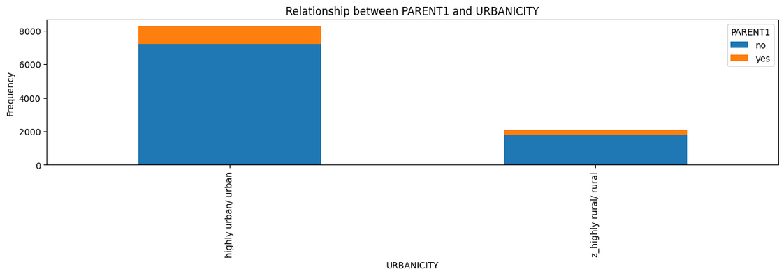
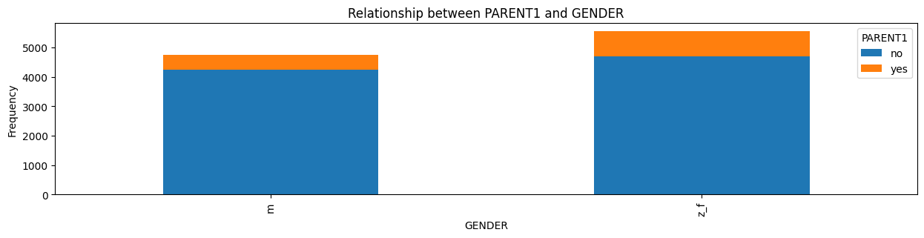
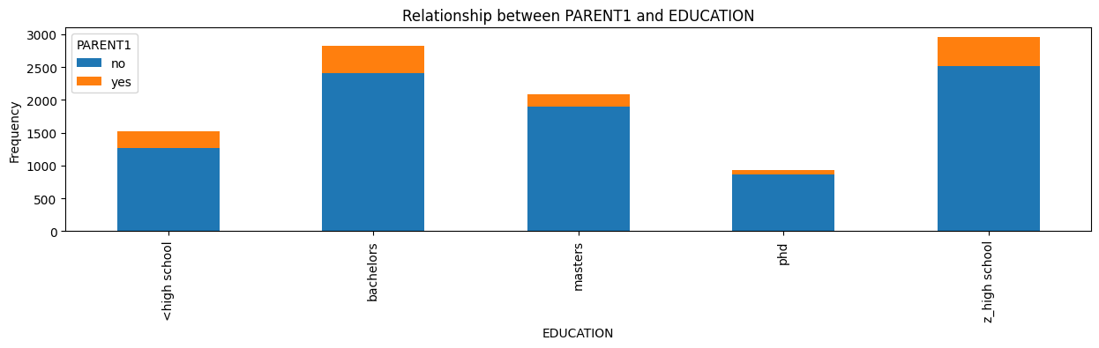
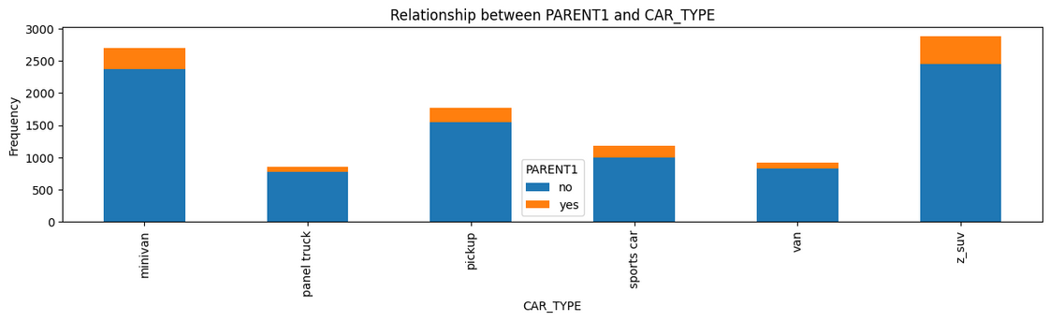
Bi-Variate
Categorical to Categorical

Slide 8
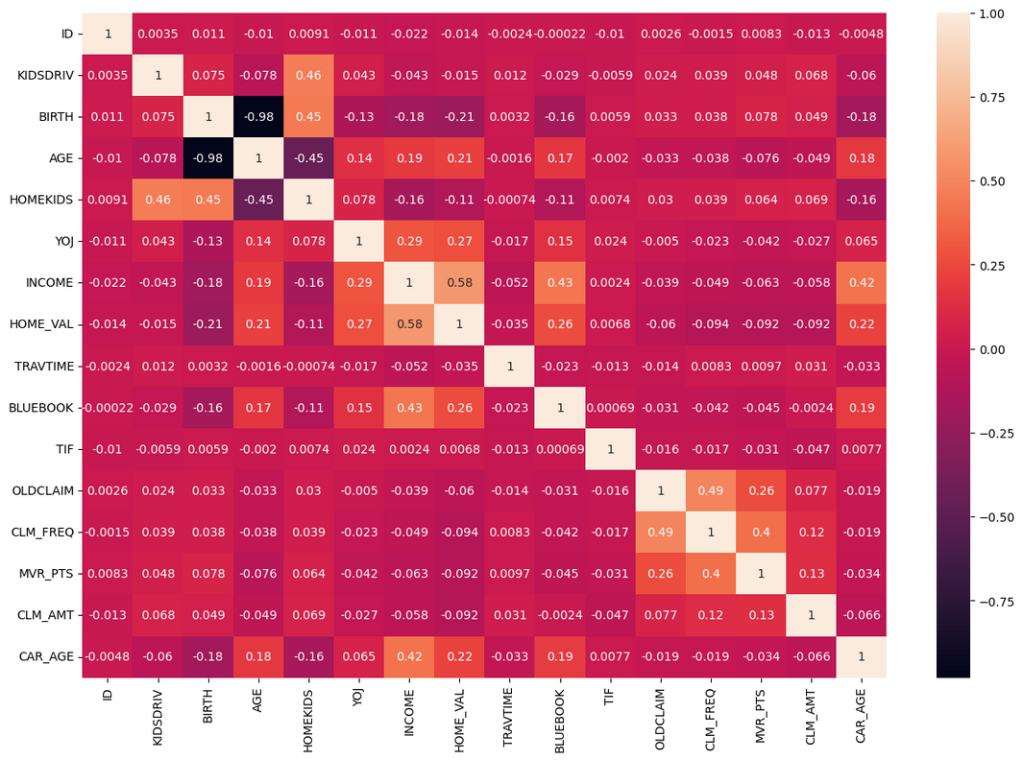
Numerical to Numerical :
INCOME and HOME_VAL: Strong positive correlation (0.58)
CLM_FREQ and OLDCLAIM: Moderately strong positive correlation (0.49)
INCOME and CAR_AGE: Moderate positive correlation (0.42).
BLUEBOOK and INCOME: Moderate positive correlation (0.43).
AGE and CAR_AGE: Slight positive correlation (0.18)
AGE and BIRTH: Strong negative correlation (-0.98).
INCOME and AGE: Weak positive correlation (0.19).
KIDSDRIV and HOMEKIDS: Positive correlation (0.46).
ACLM_AMT and CAR_AGE: Weak negative correlation (-0.06).

Slide 9
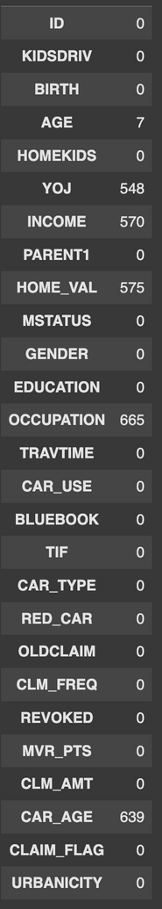
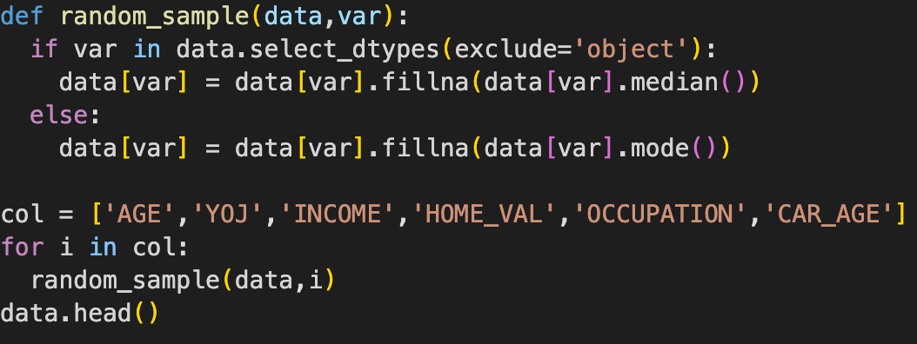
Missing Values :
We got null values in Yoj,Income,Home_val,Occupation,Age Car_Age.
We handle the null values by using median for numerical data and mode for categorical data

Slide 10
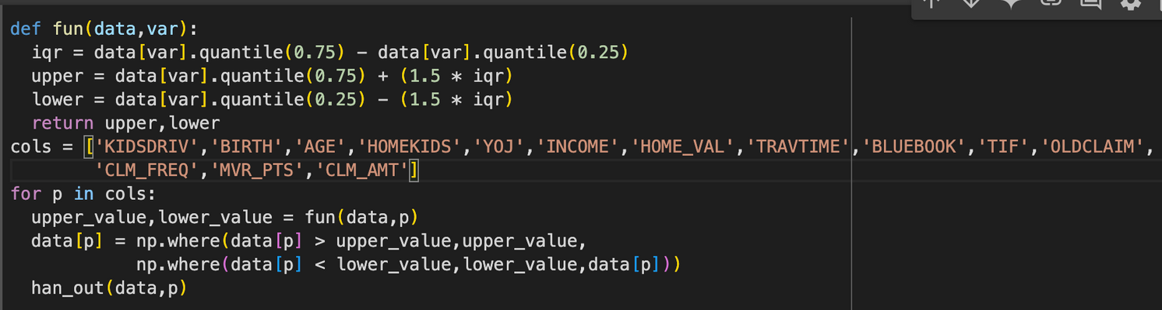
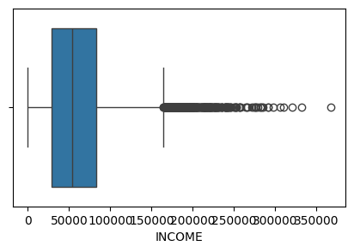
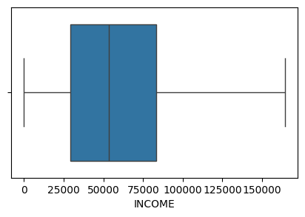
Outliers :
By using IQR ,This code identifies and handles outliers in numeric columns . It replaces extreme values with the calculated upper or lower bounds
Handling Outliers Before
Handling Outliers After

Slide 11
Predictive Modelling
Selecting X&y Features :
X FEATURES : Kidsdriv, Birth, Age, Homekids, Yoj, Income, Home_val, Mstatus, Gender, Education, Bluebook, Tif, Car_type, Oldclaim, Clm_freq, Revoked, Mvr_pts, Clm_amt, Car_age, Urbanicity.
y Features : Claim_Flag
y Features are depending on X Columns
Splitting X&y Columns
Here we are using 70% data for training and 30% for testing

Slide 12
Modeling Selection
As our y feature is categorical we have to go through the classification
The Algorithms we used :
•Logistic Regression
•K Nearest Neighbors (KNN)
•Support Vector Machine (SVM)
•Naive Bayes (NB)
•Decision Trees
•Random Forest (Bagging)
•Xgboost (Boosting)

Slide 13
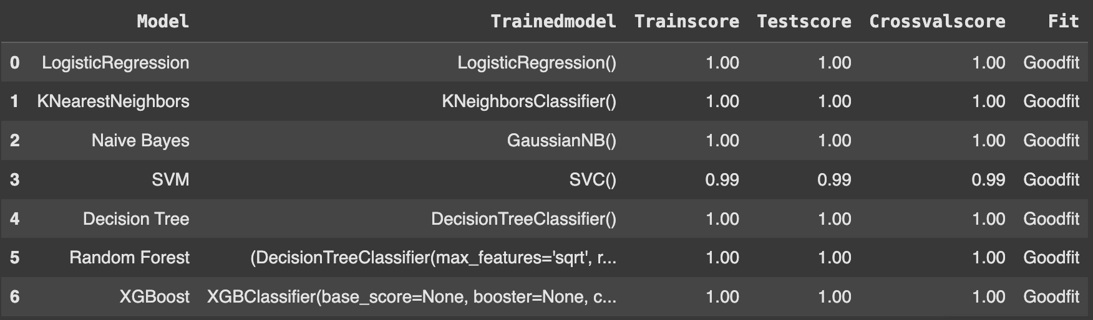
Model Training Results
Here our data is imbalanced data so we have taken F1 score

Slide 14
Model Selection
Here we selected best model as a Logistic Regression because It is has a HIGH test score and good cross-validation score and no chance of Over Fitting.

Slide 15
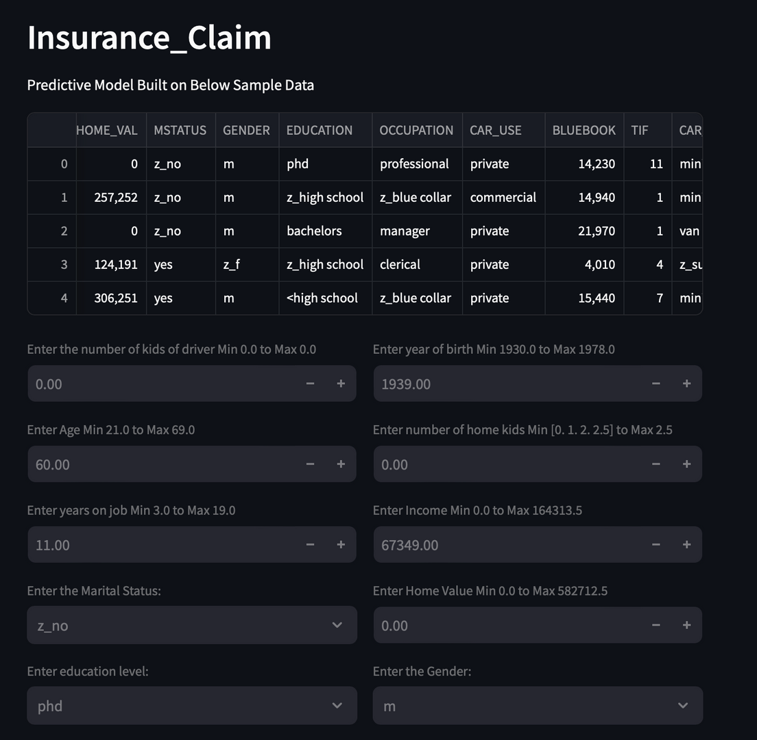
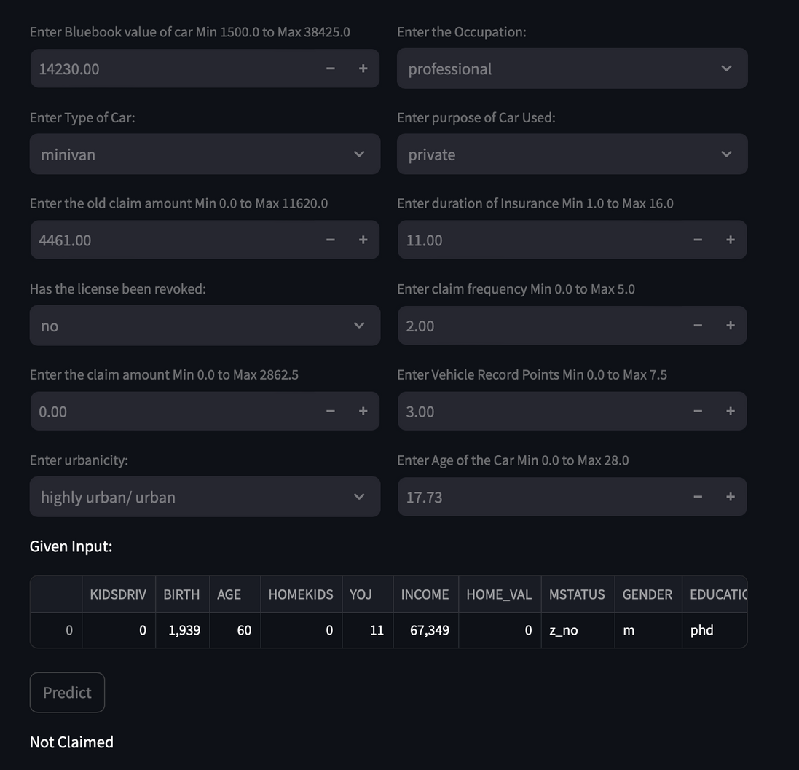
Real time Prediction

Slide 16
Cloud Deployment link
https://myappml.streamlit.app/

Slide 17



Thank you very much!

